Slide 1
Dapper
Crystal Tenn
Crystal.Tenn@microsoft.com

Slide 2
ORM
ORM (Object Relational Mapper) is a tool that creates layer between your application and data source and returns you the relational objects instead of (in terms of C# that you are using) ADO.NET objects. This is basic thing that every ORM does.
EF is considered a full ORM framework
Dapper is a micro ORM

Slide 3
Let’s start by looking at performance metrics for ADO.NET vs Dapper vs EF…
Notes:
Benefits of containers include: Density and agility, enabling agile application development and deployment
Don’t mistake Hyper-V container with a VM – containers are much more agile (deploy with a flip of the bits, etc.)

Slide 4
Performance
https://www.exceptionnotfound.net/dapper-vs-entity-framework-vs-ado-net-performance-benchmarking/
The following results are for 10 iterations, each containing 8 sports, 30 teams in each sport, and 100 players per team.

Slide 5
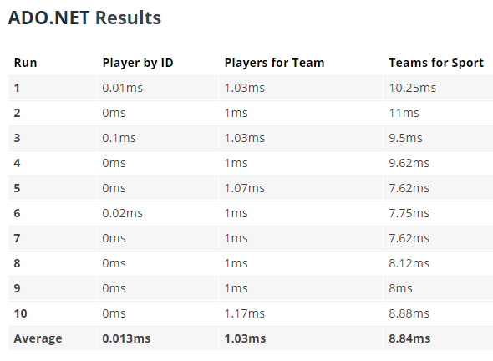
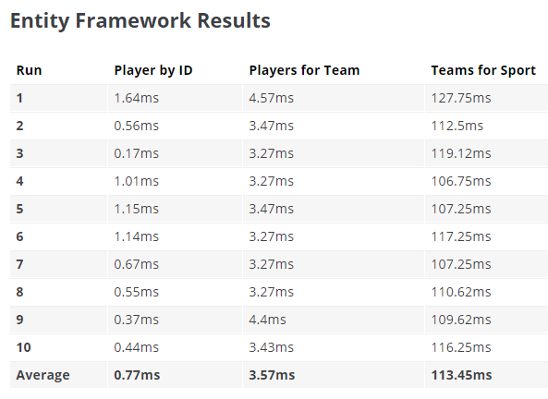
ADO.NET vs EF
Notes:
Benefits of containers include: Density and agility, enabling agile application development and deployment
Don’t mistake Hyper-V container with a VM – containers are much more agile (deploy with a flip of the bits, etc.)

Slide 6
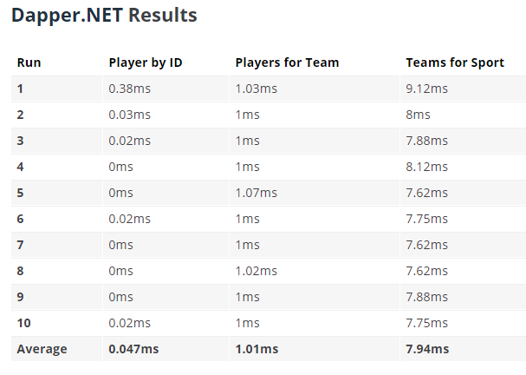
ADO.NET vs Dapper
Notes:
Benefits of containers include: Density and agility, enabling agile application development and deployment
Don’t mistake Hyper-V container with a VM – containers are much more agile (deploy with a flip of the bits, etc.)

Slide 7
EF vs Dapper
Notes:
Benefits of containers include: Density and agility, enabling agile application development and deployment
Don’t mistake Hyper-V container with a VM – containers are much more agile (deploy with a flip of the bits, etc.)

Slide 8
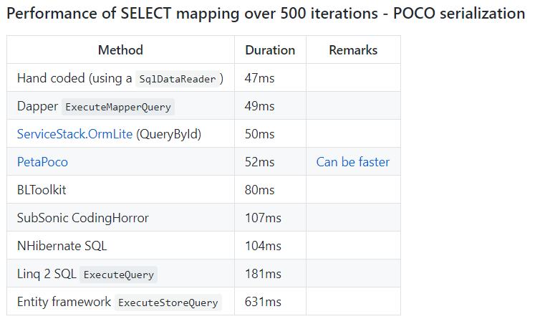
EF vs Dapper
https://github.com/StackExchange/Dapper
Notes:
Benefits of containers include: Density and agility, enabling agile application development and deployment
Don’t mistake Hyper-V container with a VM – containers are much more agile (deploy with a flip of the bits, etc.)

Slide 9
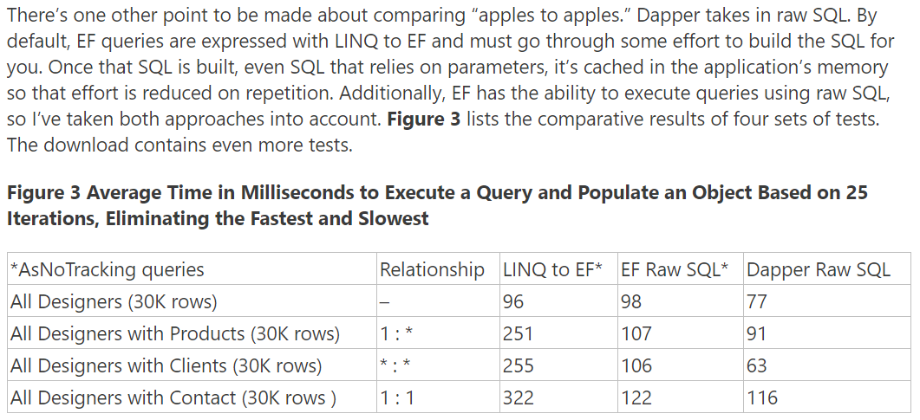
EF vs Dapper
Reference: https://msdn.microsoft.com/en-us/magazine/mt703432.aspx
Raw SQL queries using EF: https://msdn.microsoft.com/en-us/library/jj592907(v=vs.113).aspx

Slide 10
What is Dapper?
Notes:
Benefits of containers include: Density and agility, enabling agile application development and deployment
Don’t mistake Hyper-V container with a VM – containers are much more agile (deploy with a flip of the bits, etc.)

Slide 11
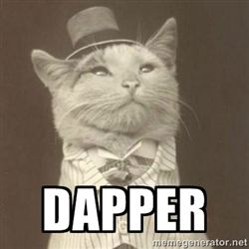
Dapper
Dapper is a simple object mapper for .NET and owns the title of King of Micro ORM in terms of speed and is virtually as fast as using a raw ADO.NET data reader. An ORM is an Object Relational Mapper, which is responsible for mapping between database and programming language.
Dapper extends the IDbConnection by providing useful extension methods to query your database.

Slide 12
Why Dapper?
Notes:
Benefits of containers include: Density and agility, enabling agile application development and deployment
Don’t mistake Hyper-V container with a VM – containers are much more agile (deploy with a flip of the bits, etc.)

Slide 13
Dapper
Dapper has an interesting history, having spawned from a resource you might be extremely familiar with: Marc Gravell and Sam Saffron built Dapper while working at Stack Overflow, solving performance issues with the platform.
In 2011, Saffron wrote a blog post about the work he and Gravell had done, titled, “How I Learned to Stop Worrying and Write My Own ORM” (aka.ms/Vqpql6), which explains the performance issues Stack was having at the time, stemming from its use of LINQ to SQL.
He then details why writing a custom ORM, Dapper, was the answer for optimizing data access on Stack Overflow. Five years later, Dapper is now widely used and open source. Gravell and Stack and team member Nick Craver continue to actively manage the project at github.com/StackExchange/dapper-dot-net.
https://msdn.microsoft.com/en-us/magazine/mt703432.aspx

Slide 14
What is Dapper?
Notes:
Benefits of containers include: Density and agility, enabling agile application development and deployment
Don’t mistake Hyper-V container with a VM – containers are much more agile (deploy with a flip of the bits, etc.)

Slide 15

3 step process to Dapper
Create an IDbConnection object.
Write a query to perform CRUD operations.
Pass query as a parameter in Execute method.

Slide 16

3 step process to Dapper
Dapper works with any database provider since there is no DB specific implementation.
Dapper will extend your IDbConnection interface with multiple methods:
Execute
Query *get me a list of objects
QueryFirst
QueryFirstOrDefault
QuerySingle *get me the first result
QuerySingleOrDefault
QueryMultiple *more than 1 select statement

Slide 17
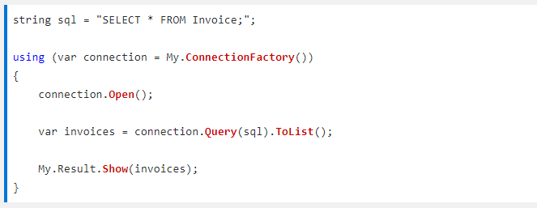
Query

Slide 18
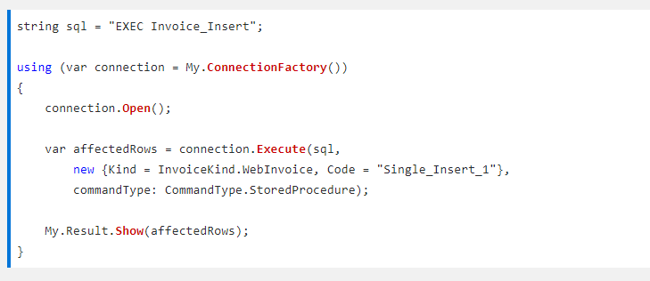
Query

Slide 19
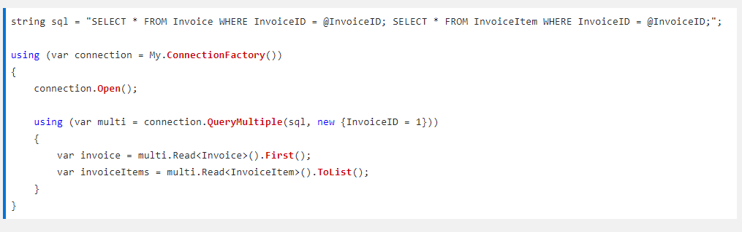
Query Mutliple
Notice more than 1 select statement
2 Selects here will get you 2 result sets, the Grid Reader is used to read them
“var multi” is a Grid Reader
It is a way of getting multiple result sets, and you have to use the .Read method to get each result set out.

Slide 20
What is Entity Framework?
Notes:
Benefits of containers include: Density and agility, enabling agile application development and deployment
Don’t mistake Hyper-V container with a VM – containers are much more agile (deploy with a flip of the bits, etc.)

Slide 21
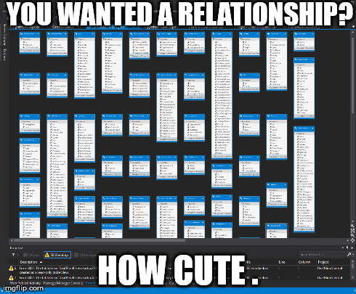
Entity Framework
Entity Framework (EF) is an open source object-relational mapping (ORM) framework for ADO.NET. It was a part of .NET Framework, but since Entity framework version 6 it is separated from .NET framework.

Slide 22
Entity Framework
Features for Database First (Designer)
and Code-First Both:
Connection resiliency
Asynchronous query and save
Code-based configuration
Database command logging
Database command interception
Dependency Resolution
DbSet.AddRange/RemoveRange
Better Transaction Support
Pluggable pluralisation and singularization service
Testability improvements
Creating context with an open connection
Improved performance and warm-up time
Features for Code-First:
Custom conventions
Insert, update & delete stored procedures for entity CUD operation
Index attribute (EF 6.1)
Multiple context per database
Nested entity types
Custom migration operations
Configurable migration history table

Slide 23
Lab on Dapper
01 ToDoListDataAPI [begin], continued from your work in Lab 1 on Swagger. We will convert the ADO.NET in the application to Dapper.
Notes:
End 37 mins

Slide 24
Thank you!

